Slide 1
Matthew 2:1-12

Slide 2
1 After Jesus was born in Bethlehem in Judea, during the time of King Herod, Magi from the east came to Jerusalem
2 and asked, “Where is the One who has been born King of the Jews? We saw His star when it rose and have come to worship Him.” 3 When King Herod heard this he was disturbed, and all Jerusalem with him. 4 When he had called together all the people’s chief priests and teachers of the law, he asked them where the Messiah was to be born. 5 “In Bethlehem in Judea,” they replied, “for this is what the prophet has written: 6 “‘But you, Bethlehem, in the land of Judah, are by no means least among the rulers of Judah; for out of you will come a ruler
who will shepherd My people Israel.’”

Slide 3
7 Then Herod called the Magi secretly and found out from them the exact time the star had appeared. 8 He sent them to Bethlehem and said, “Go and search carefully for the Child. As soon as you find Him, report to me, so that I too may go and worship Him.”
9 After they had heard the king, they went on their way, and the star they had seen when it rose went ahead of them until it stopped over the place where the Child was. 10 When they saw the star, they were overjoyed.
11 On coming to the house, they saw the Child with His mother Mary, and they bowed down and worshiped Him. Then they opened their treasures and presented Him with gifts of gold, frankincense, and myrrh.
12 And having been warned in a dream not to go back to Herod, they returned to their country by another route.

Slide 4
The arrival of Jesus invites us to also follow the STAR
See Him
Treasure His worth, in worship
Acknowledge His Lordship
Rejoice in His Presence

Slide 5
Daniel 2:48
Then the king promoted Daniel and gave him many great gifts; and he made him ruler over the whole province of Babylon, and chief administrator over all the wise men of Babylon.

Slide 6
Numbers 24:17
I see Him, but not now; I behold Him, but not near. A Star shall come out of Jacob; A Scepter shall rise out of Israel."

Slide 7
Hebrews 1:1-2
In the past God spoke to our ancestors through the prophets at many times and in various ways, but in these last days He has spoken to us by His Son.

Slide 8
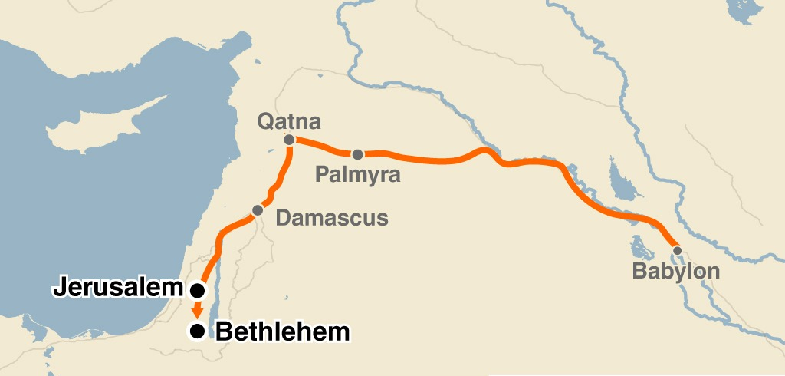

Slide 9
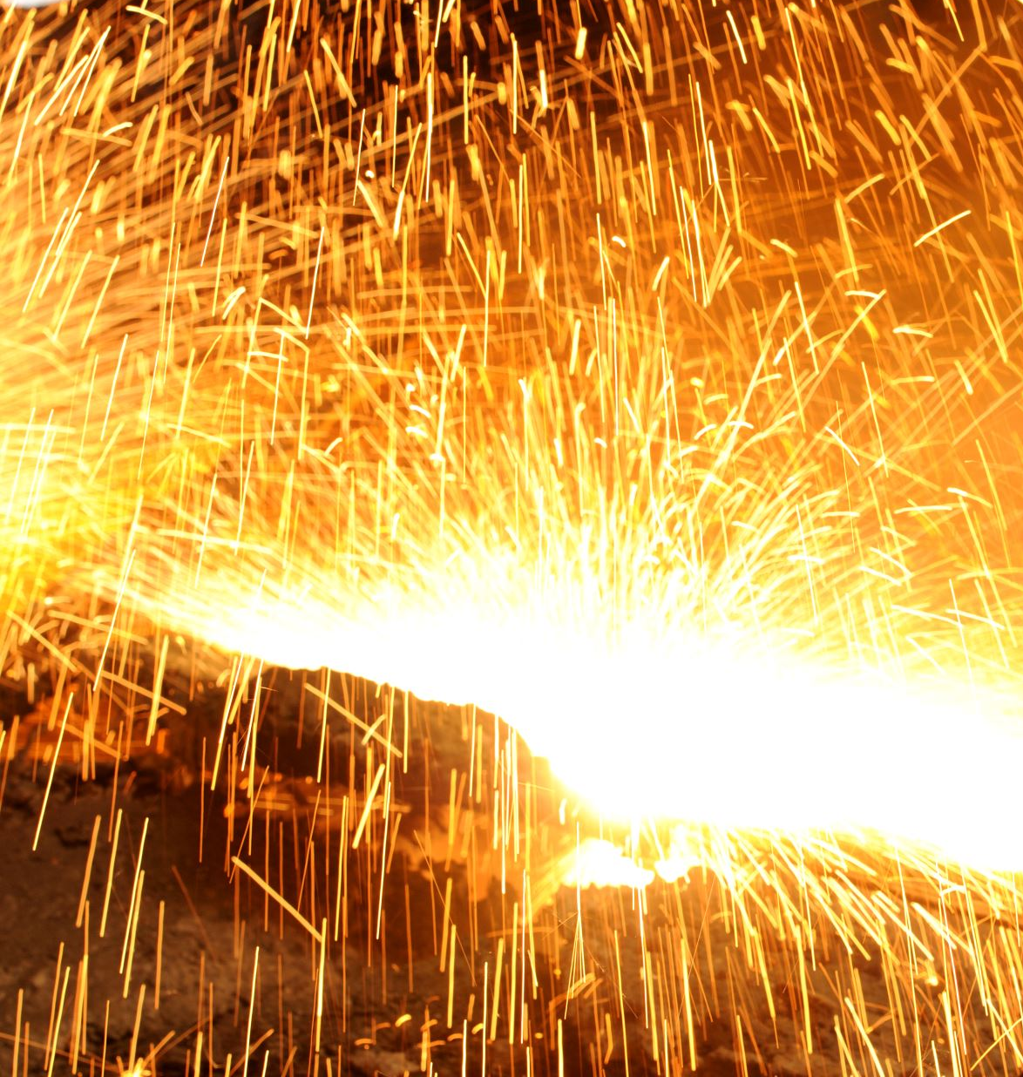
Revelation requires response

Slide 10
Micah 5:2
But you, Bethlehem... out of you shall come a Ruler who will shepherd My people Israel.

Slide 11
Which of the 3 am I right now?
The Seeking Heart: The Magi
The Fearful Heart: Herod
The Indifferent Heart: The Religious Leaders

Slide 12
Worship is the heart’s response to what it values most

Slide 13
"Those who look for Jesus will see Him; those who truly see Him will worship Him; those who worship Him will consecrate their substance to Him.“
Charles Spurgeon

Slide 14
So, the magi were men who
1) read and believed God’s Word
2) sought Jesus
3) recognized the worth of Christ
4) humbled themselves to worship Jesus
5) obeyed God rather than man
They were truly wise men!
gotquestions.org

