Slide 1
²⁵ Now about virgins: I have no command from the Lord, but I give a judgment as one who by the Lord’s mercy is trustworthy. ²⁶ Because of the present crisis, I think that it is good for a man to remain as he is. ²⁷ Are you pledged to a woman? Do not seek to be released. Are you free from such a commitment? Do not look for a wife. ²⁸ But if you do marry, you have not sinned; and if a virgin marries, she has not sinned. But those who marry will face many troubles in this life, and I want to spare you this.
²⁹ What I mean, brothers and sisters, is that the time is short. From now on those who have wives should live as if they do not; ³⁰ those who mourn, as if they did not; those who are happy, as if they were not; those who buy something, as if it were not theirs to keep; ³¹ those who use the things of the world, as if not engrossed in them. For this world in its present form is passing away.

Slide 2
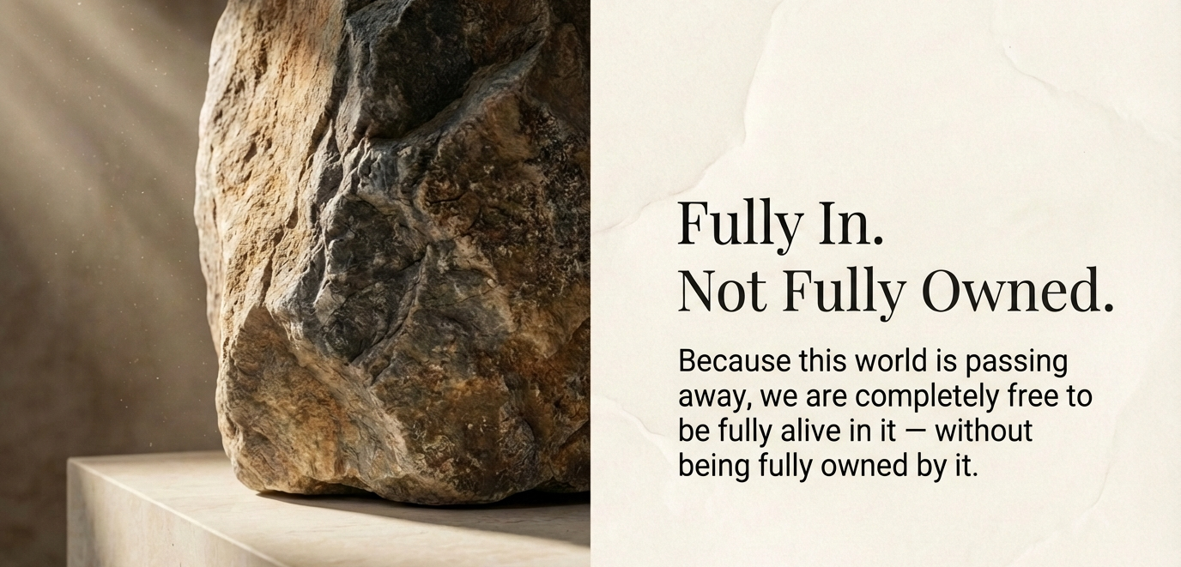

Slide 3
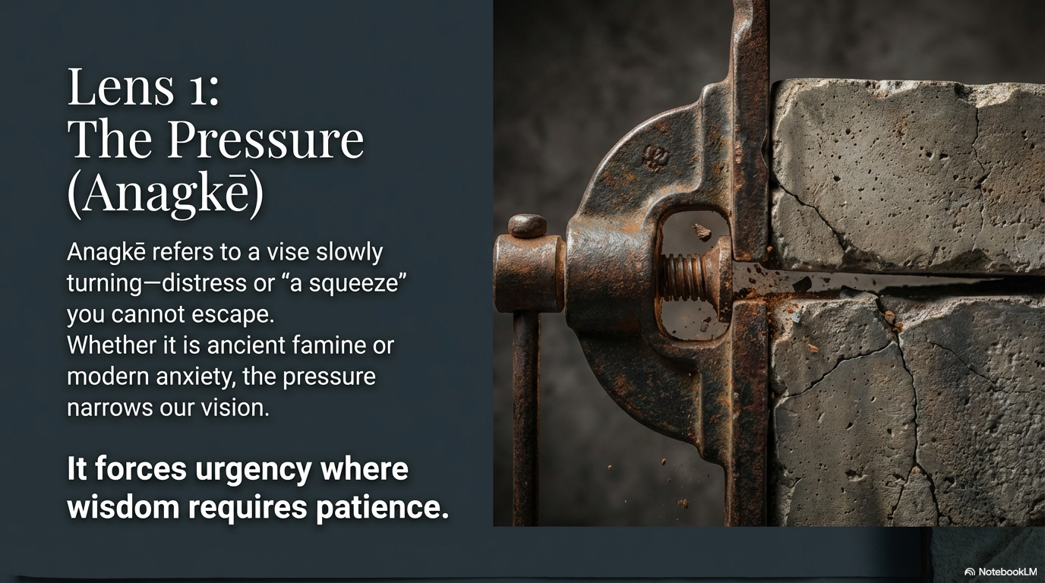

Slide 4
John 16:2
A time is coming when anyone who kills you will think they are offering a service to God.

Slide 5
Matthew 6:33
But seek first His kingdom and His righteousness, and all these things will be given to you as well

Slide 6
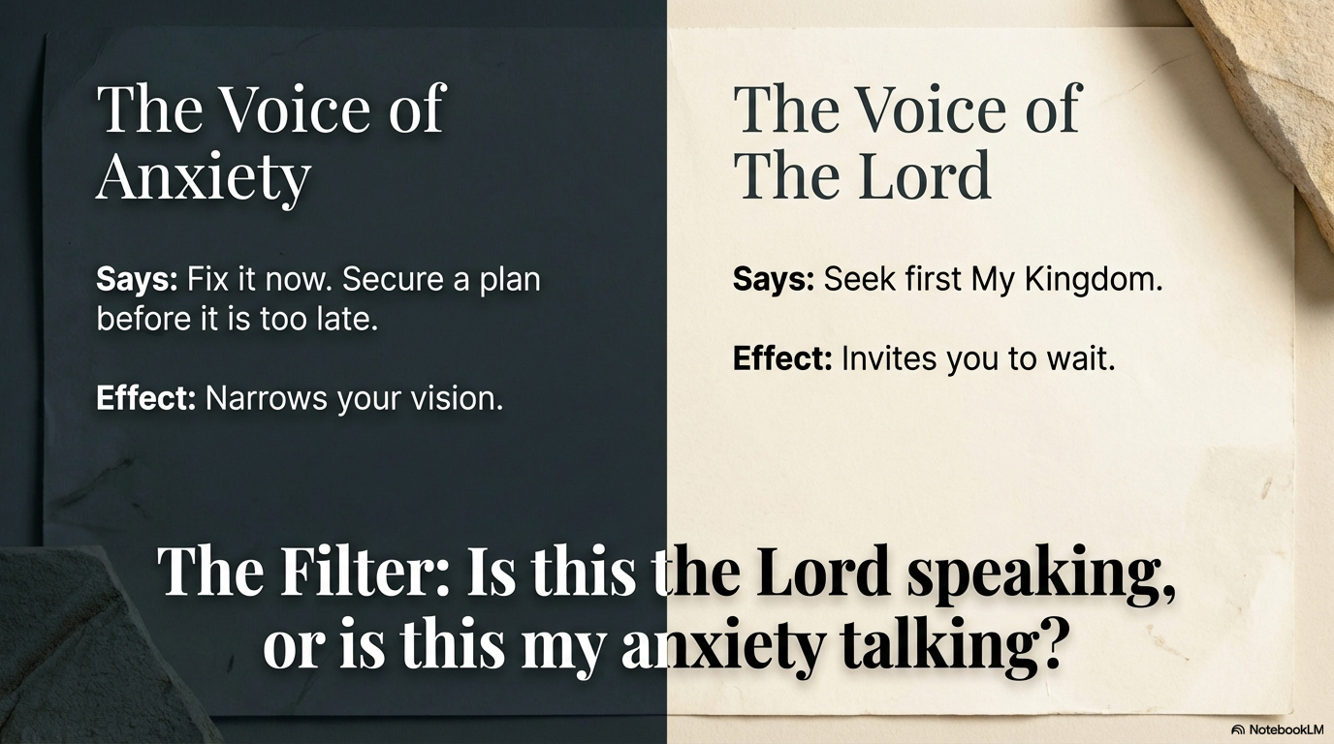

Slide 7
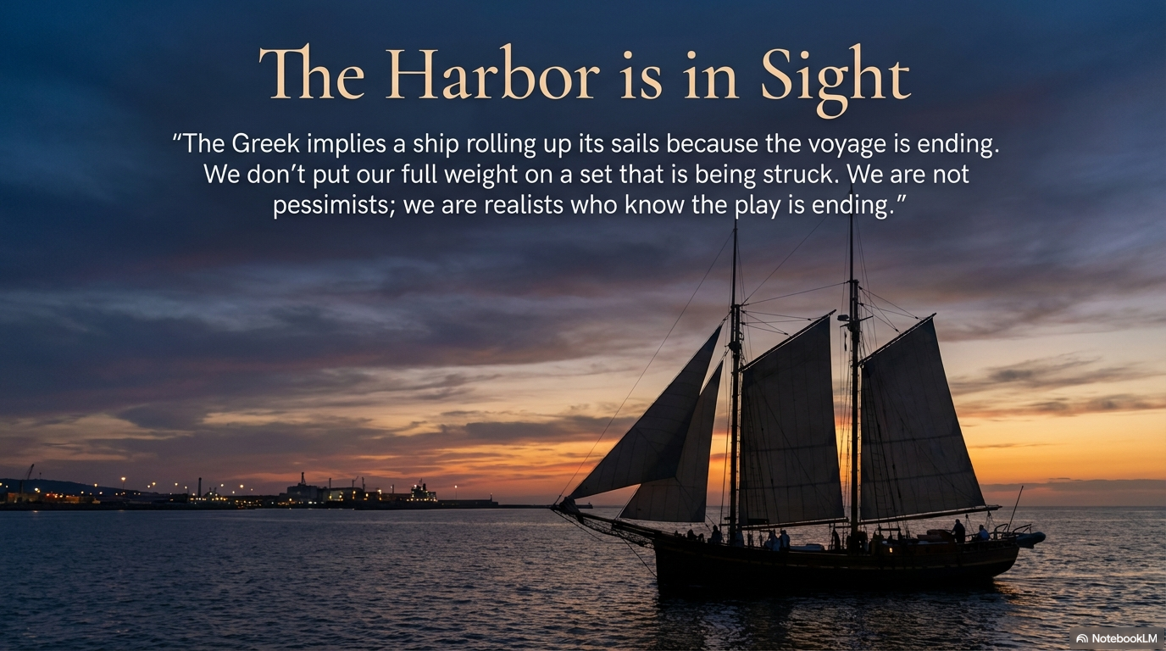

Slide 8
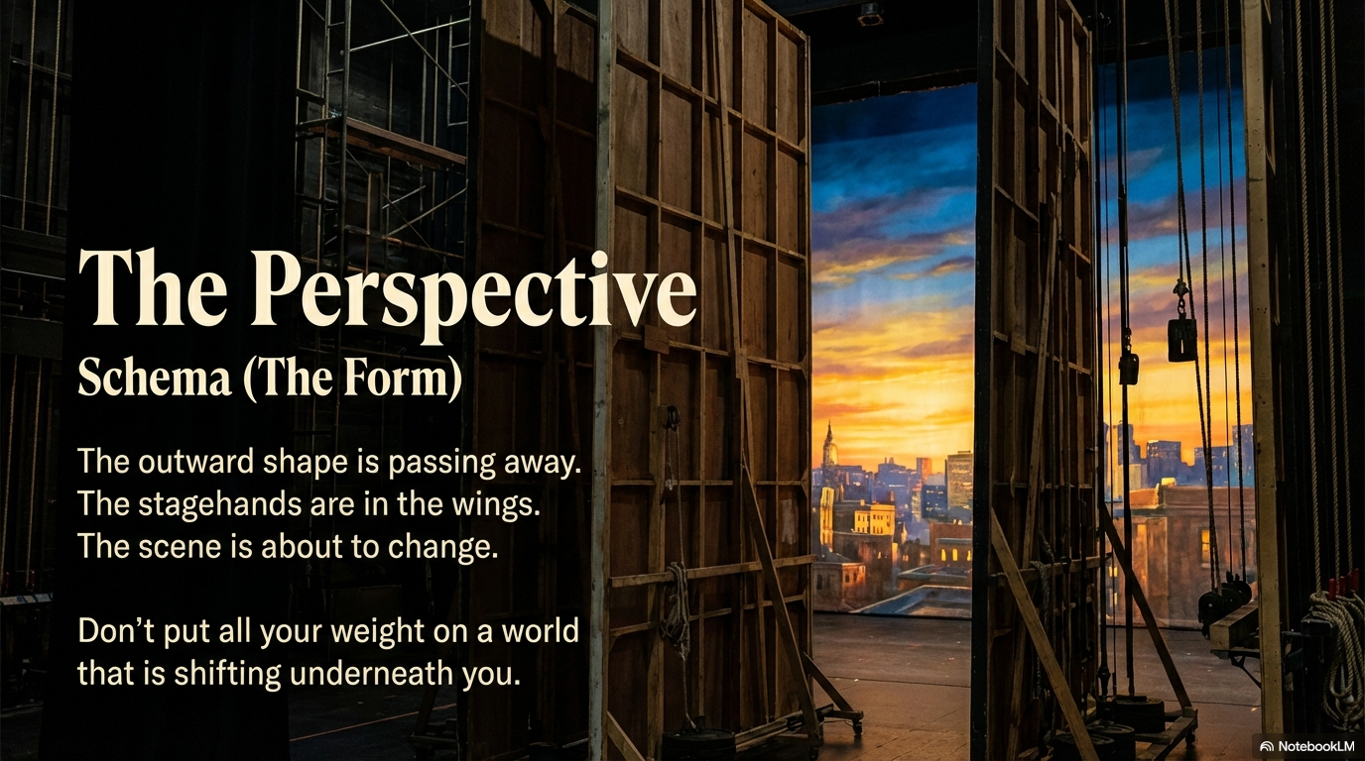

Slide 9
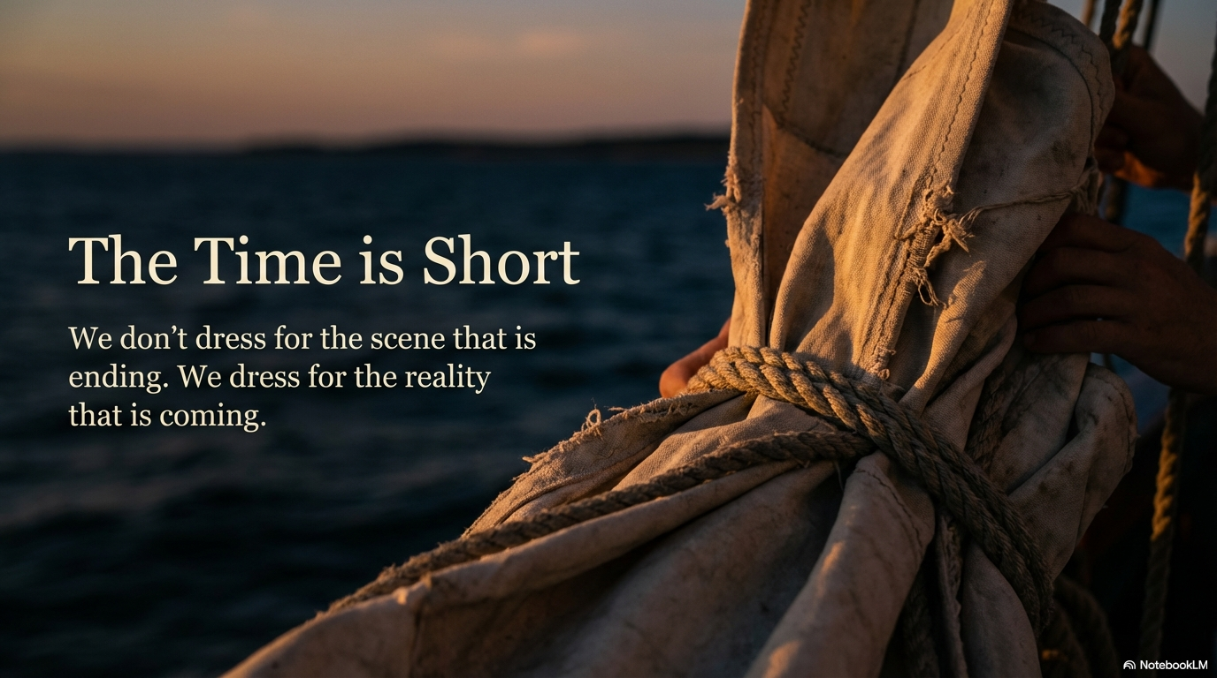

Slide 10
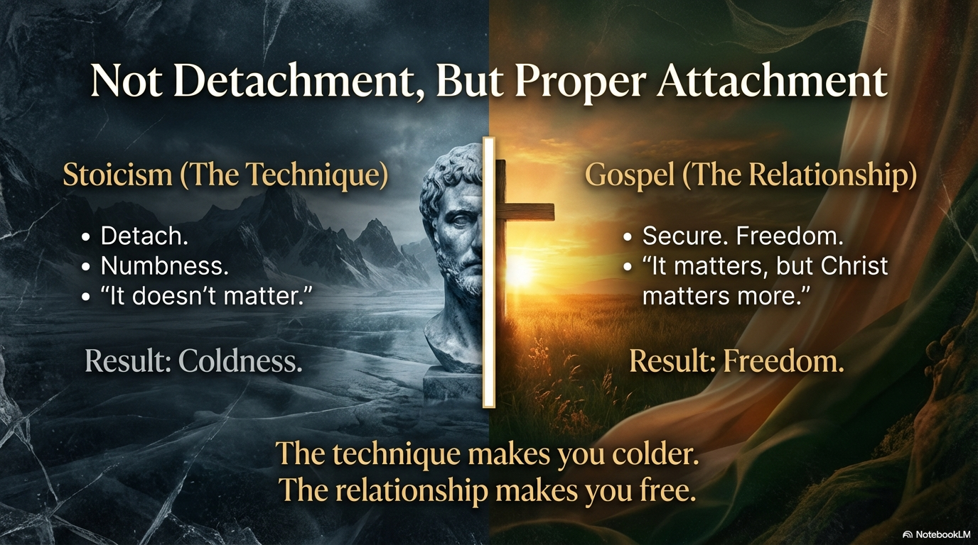

Slide 12
2 Corinthians 4:18
we fix our eyes not on what is seen, but on what is unseen. Because what is seen is temporary. What is unseen is eternal.

Slide 13
Psalm 24:1
The earth is the Lord's, and everything in it, the world and all who live in it.

Slide 14
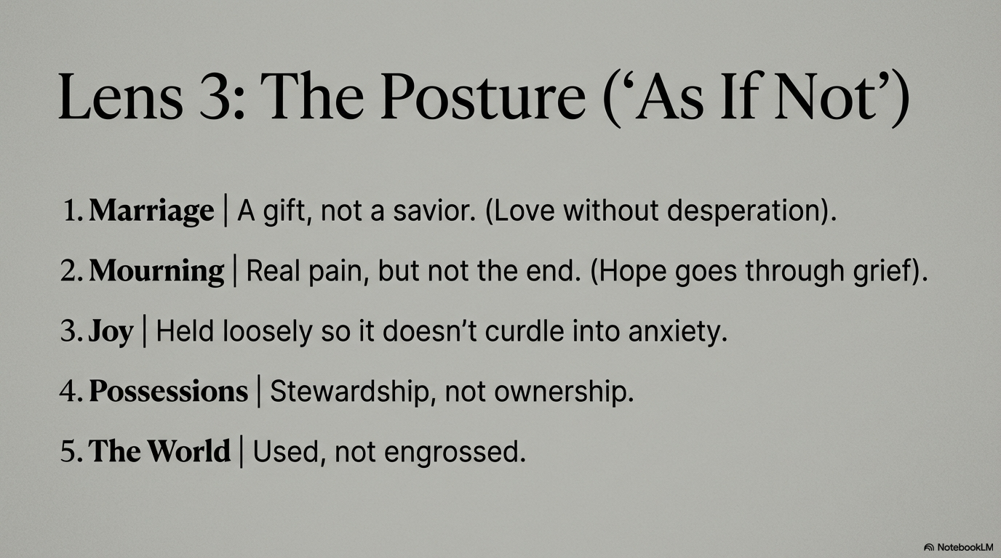

Slide 15
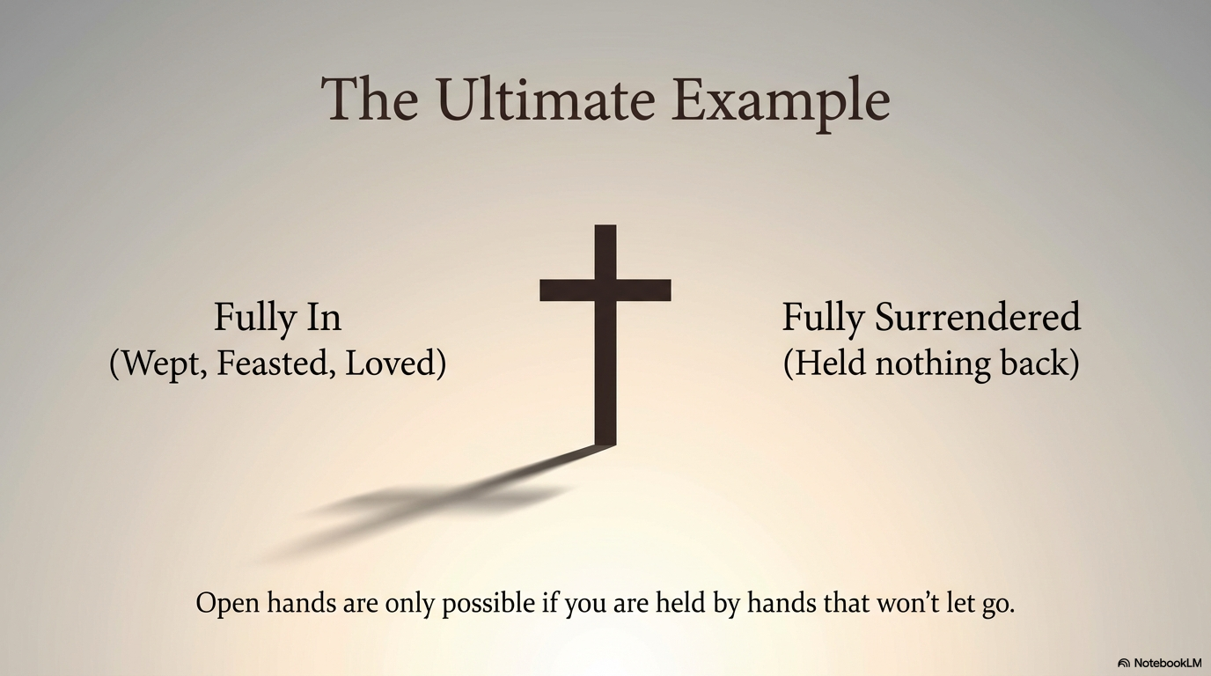

Slide 16
Colossians 3:3
For you died, and your life is now hidden with Christ in God.

Slide 17
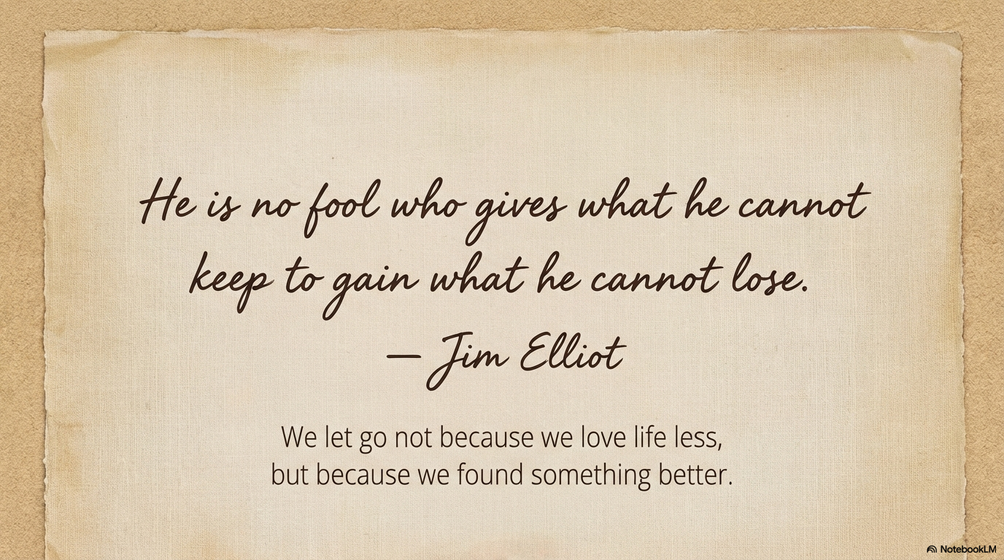


Slide 18
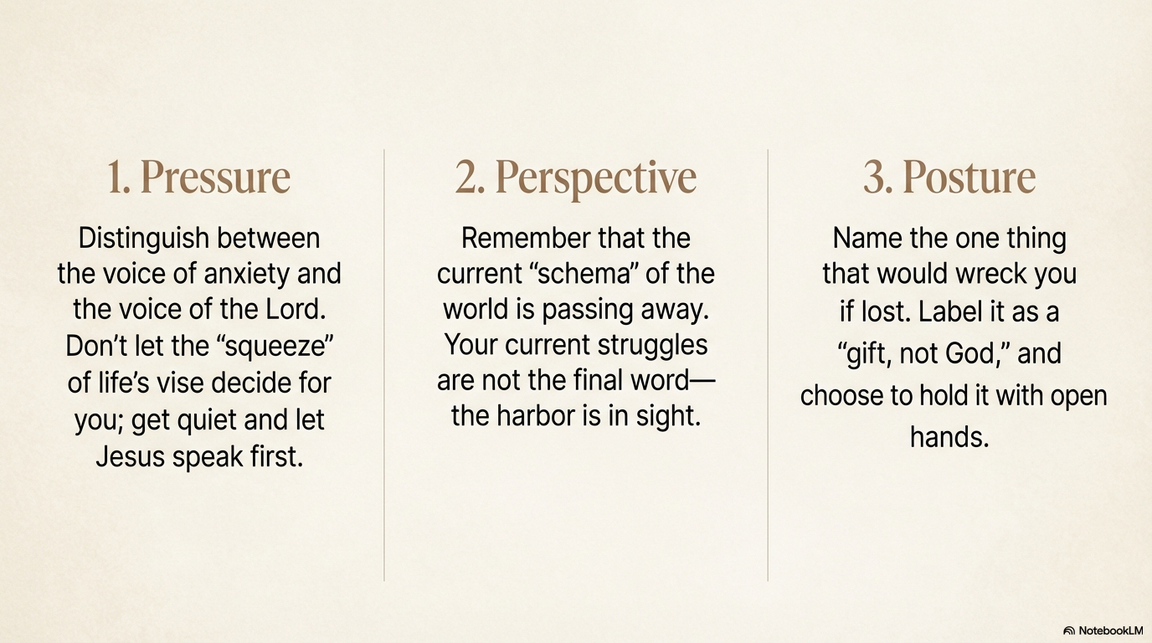

Slide 21
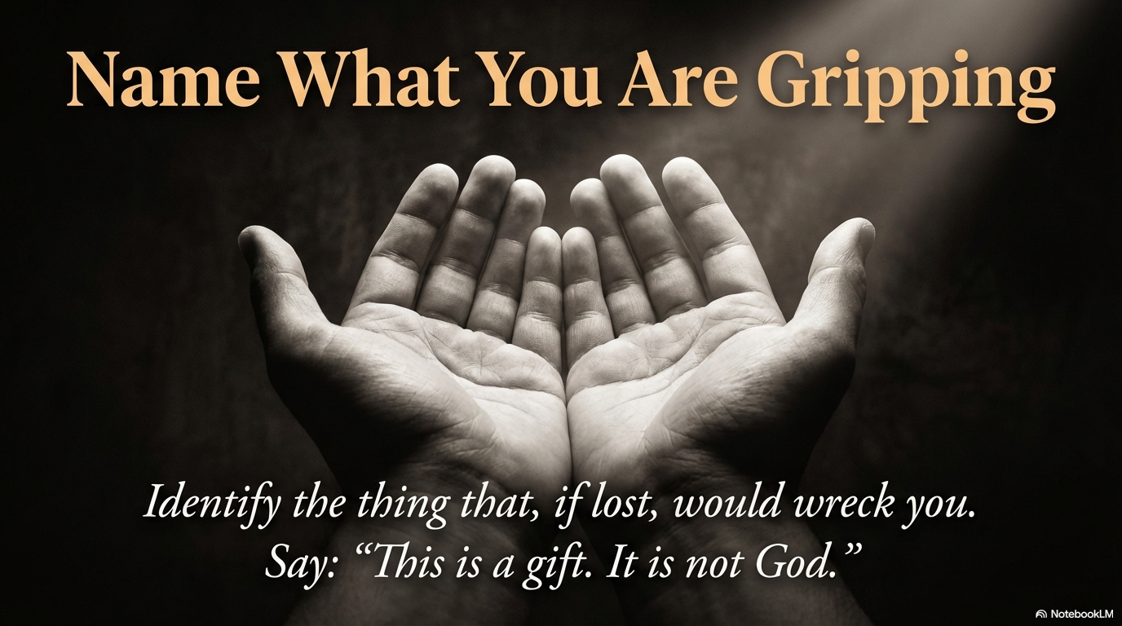

Slide 22
