Slide 1

Chapter 8:4-6
Chapter 8:4-6
Chapter 8:1-13

Slide 2
¹ Now about food sacrificed to idols: We know that “We all possess knowledge.” But knowledge puffs up while love builds up.
² Those who think they know something do not yet know as they ought to know. ³ But whoever loves God is known by God.
⁴ So then, about eating food sacrificed to idols: We know that “An idol is nothing at all in the world” and that “There is no God but one.” ⁵ For even if there are so-called gods, whether in heaven or on earth (as indeed there are many “gods” and many “lords”), ⁶ yet for us there is but one God, the Father, from whom all things came and for whom we live; and there is but one Lord, Jesus Christ, through whom all things came and through whom we live.

Slide 3
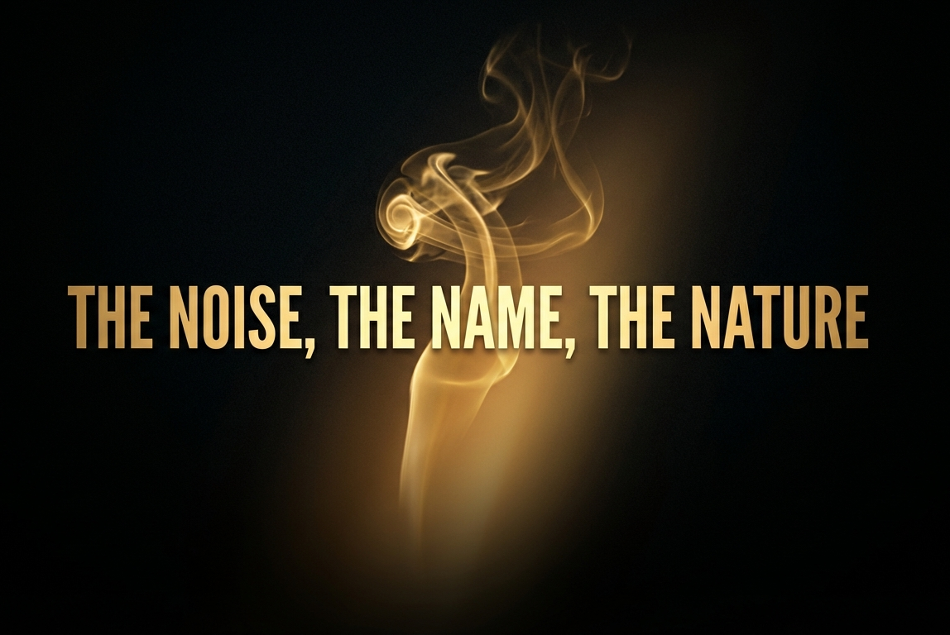

Slide 4
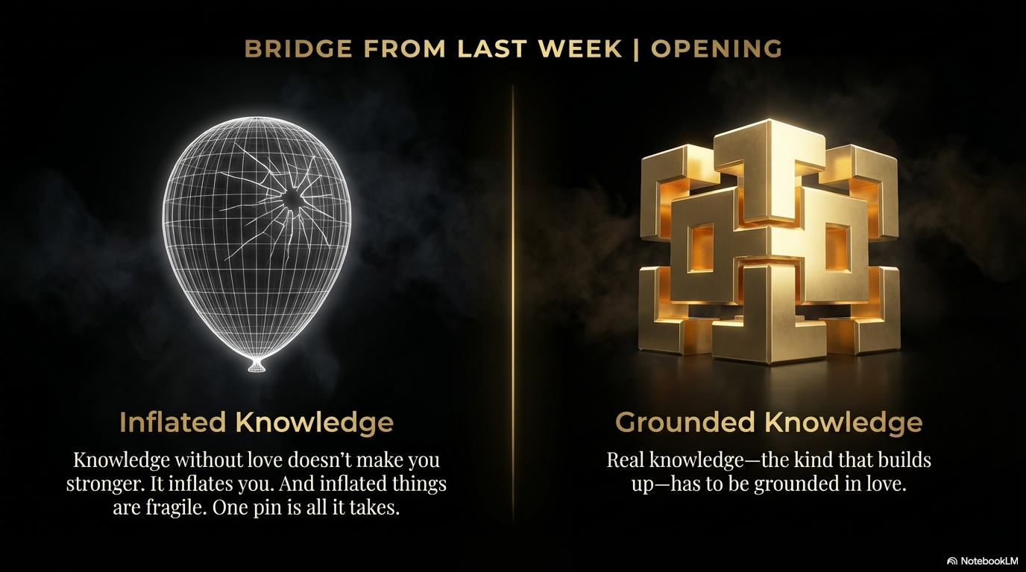

Slide 5
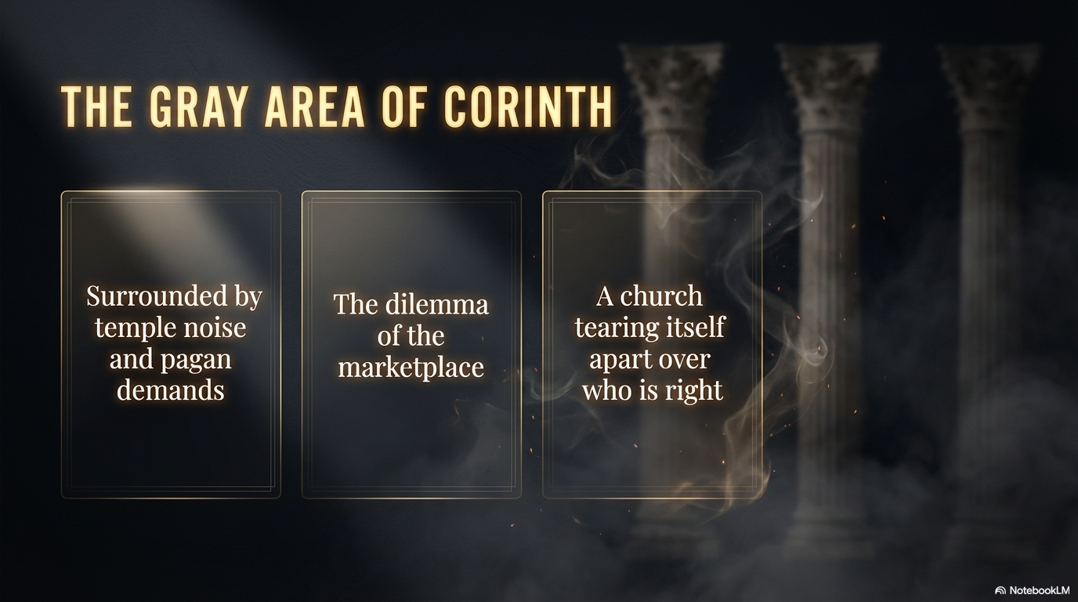

Slide 6
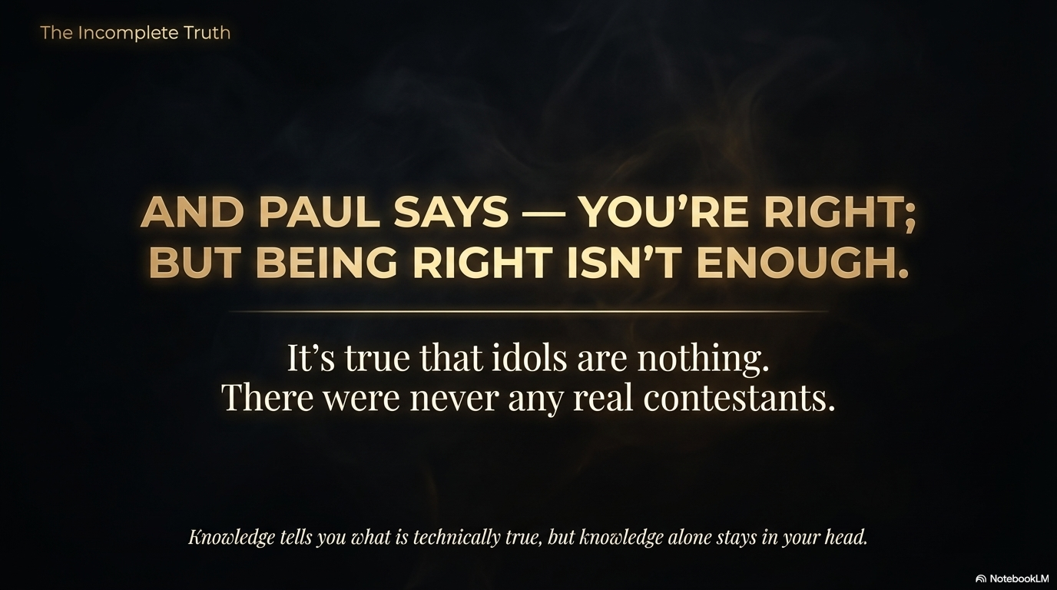

Slide 7
Psalm 115:4-8
But their idols are silver and gold, made by human hands. ⁵ They have mouths, but cannot speak, eyes, but cannot see. ⁶ They have ears, but cannot hear, noses, but cannot smell. ⁷ They have hands, but cannot feel, feet, but cannot walk, nor can they utter a sound with their throats. ⁸ Those who make them will be like them, and so will all who trust in them.

Slide 8
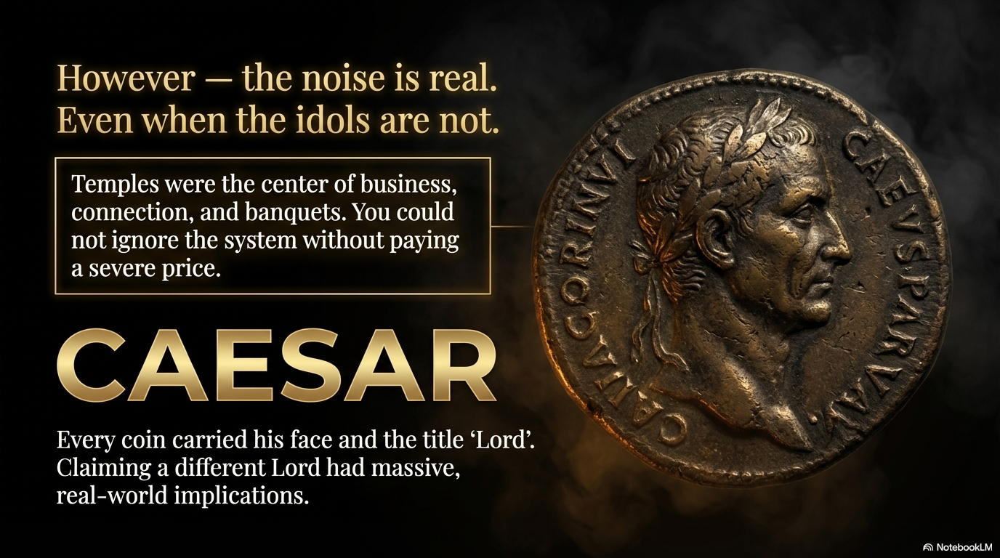

Slide 9
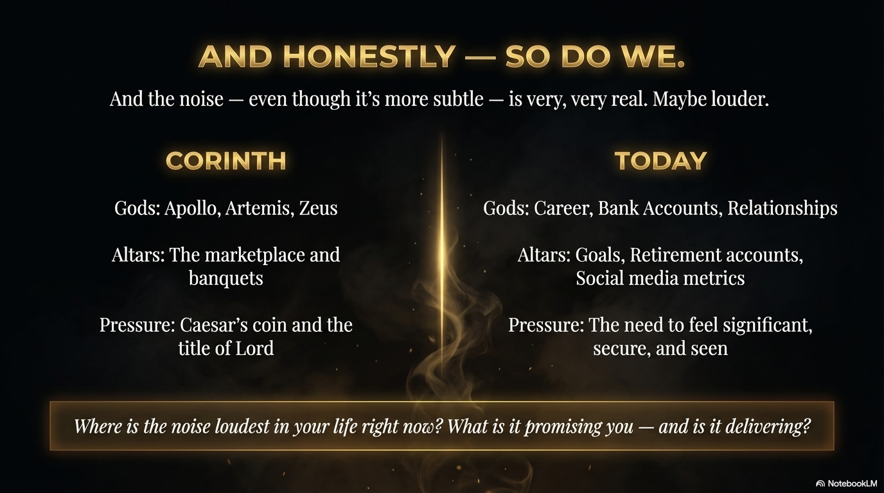

Slide 10
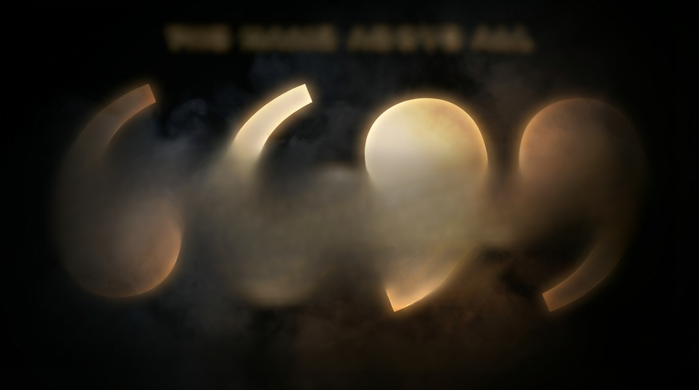
THE NAME ABOVE ALL
You don't answer noise with
louder noise. You answer noise
with a Name.
Before giving instructions on how to live, the reminder is placed on identity:
You do not belong to the noise; you belong to the Only True God.

Slide 11
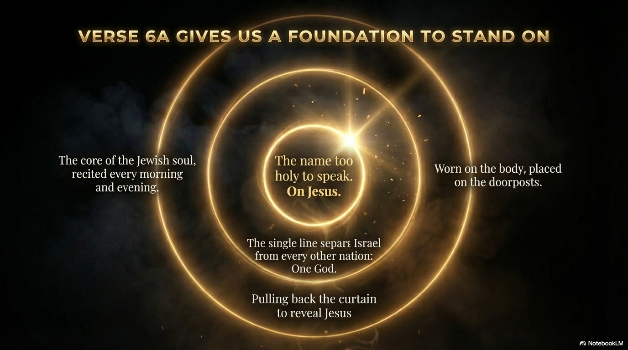

Slide 12
Colossians 1:17
He is before all things, and in Him all things hold together.

Slide 13
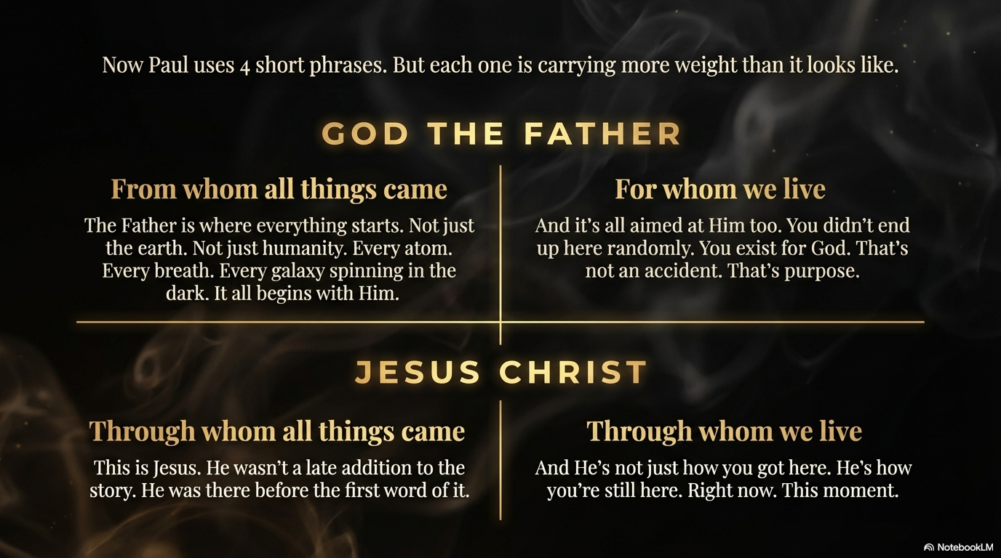

Slide 14
John 1:1
In the beginning was the Word, and the Word was with God, and the Word was God. He was with God in the beginning. Through Him all things were made; without Him nothing was made that has been made.

Slide 15
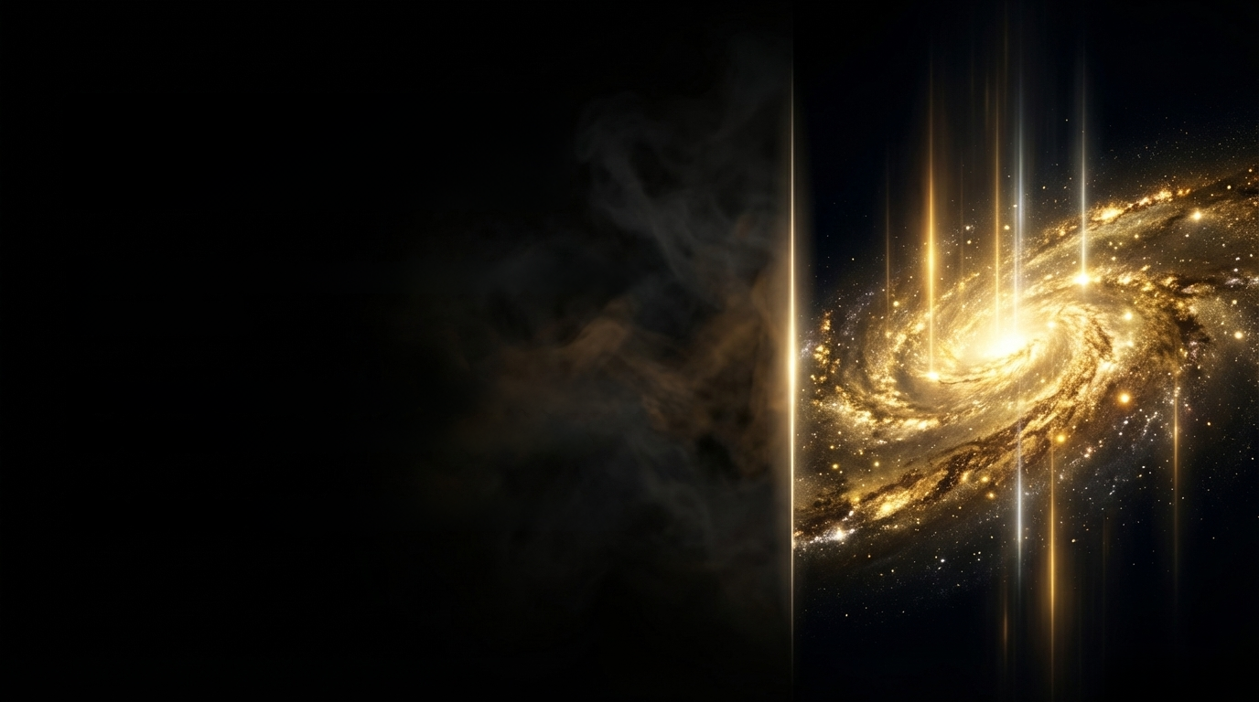
THE NATURE
OF OUR LORD
Standing in the moment before the first star existed.
Jesus was already there. Remove Him from the equation, and you have nothing.
The Creator stepping into human skin.

Slide 16
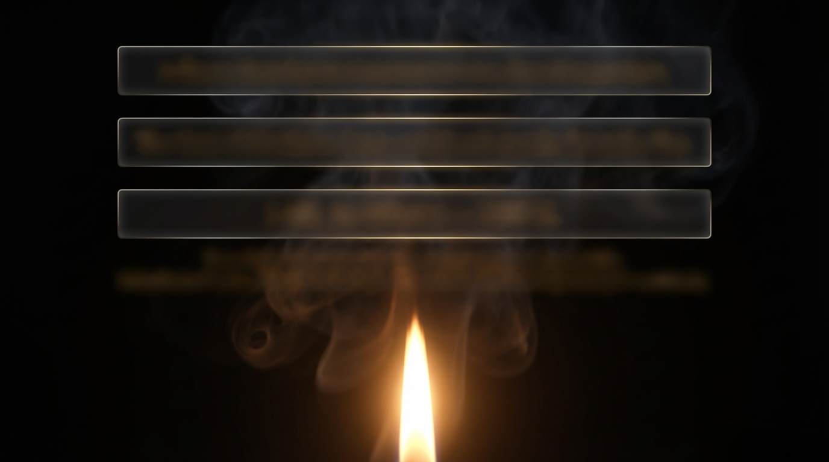
A flame that does not consume on a desert mountain.
The God of Abraham, Isaac, and Jacob speaks from the fire.
I AM. In Hebrew - YHWH.
Four letters so sacred they became unpronounceable.
Substituted with Adonai, meaning Lord, rather than risk speaking it carelessly.

Slide 17
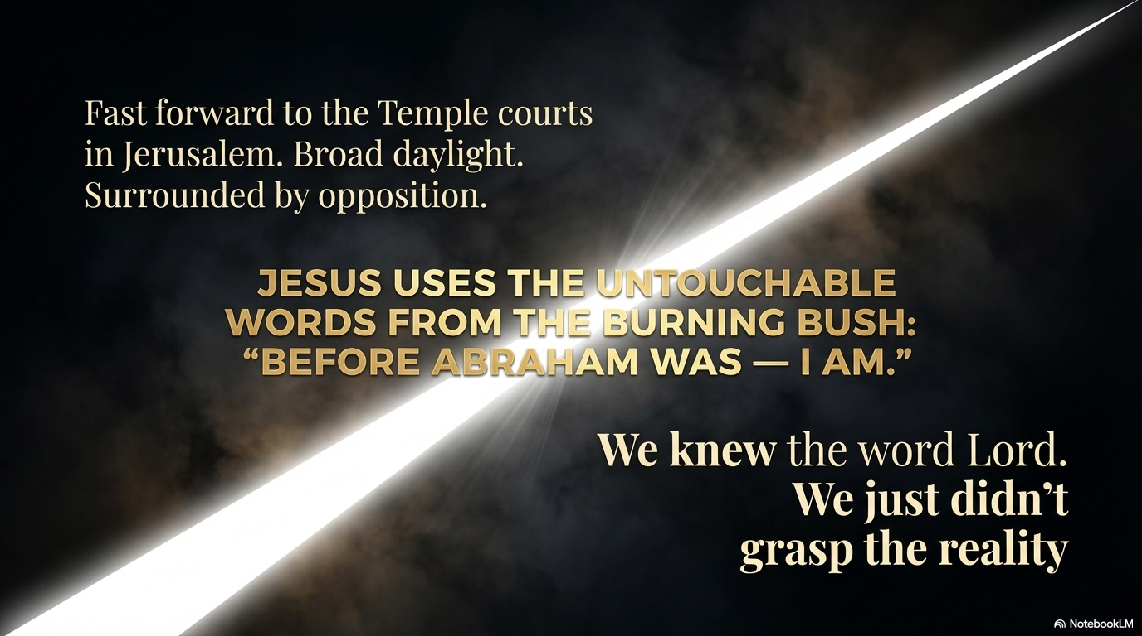

Slide 18
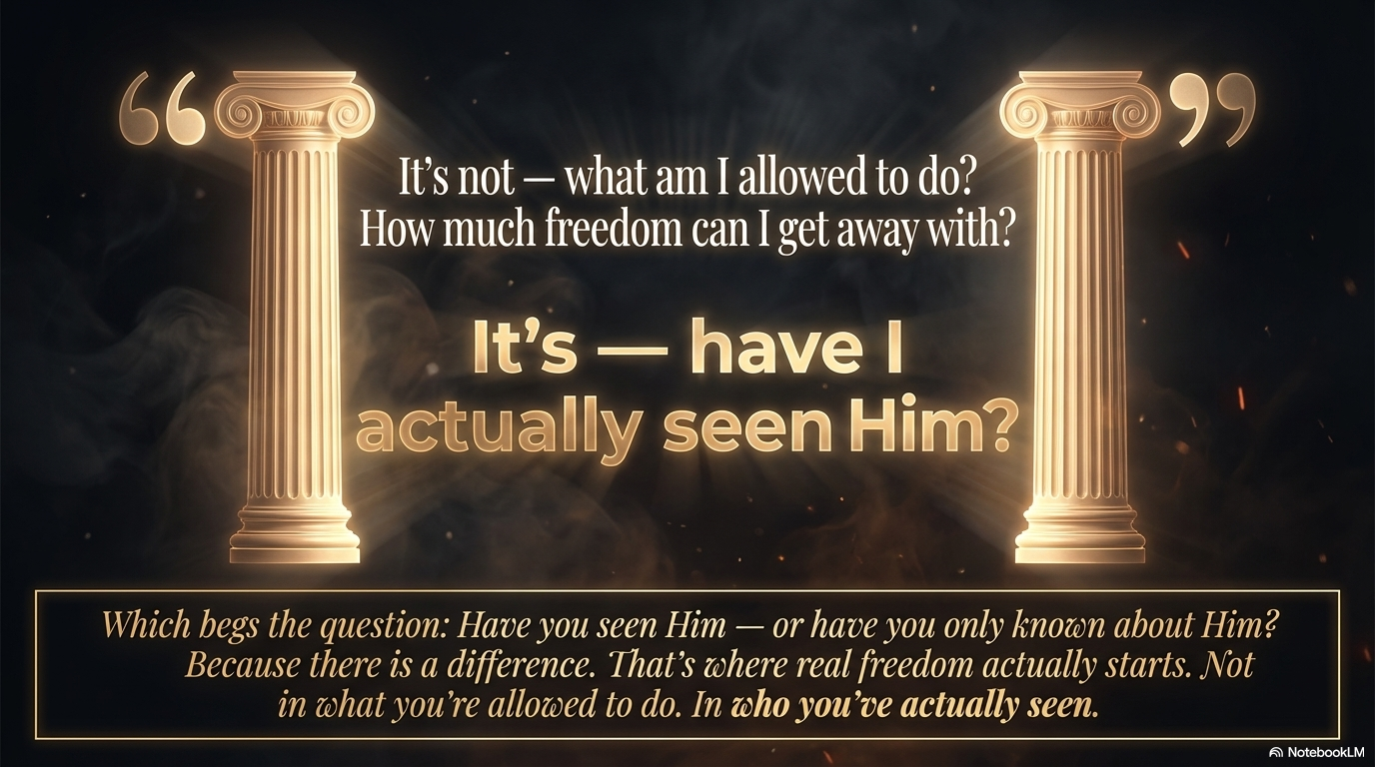

Slide 19
